Slide 1



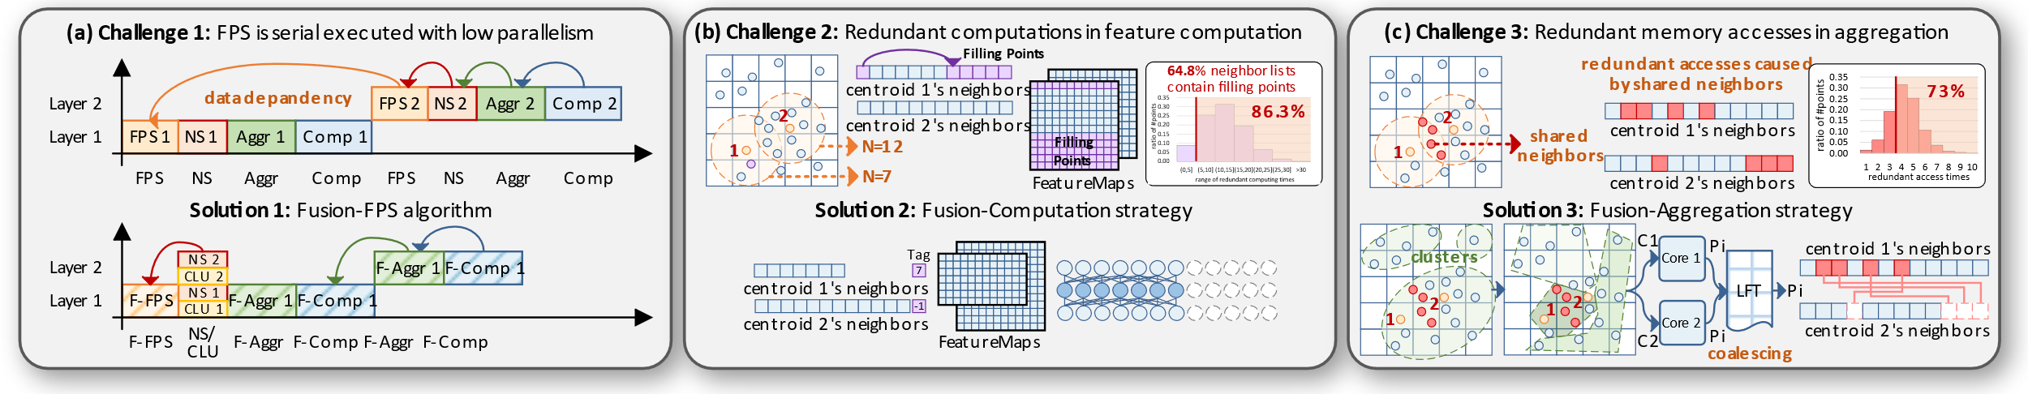
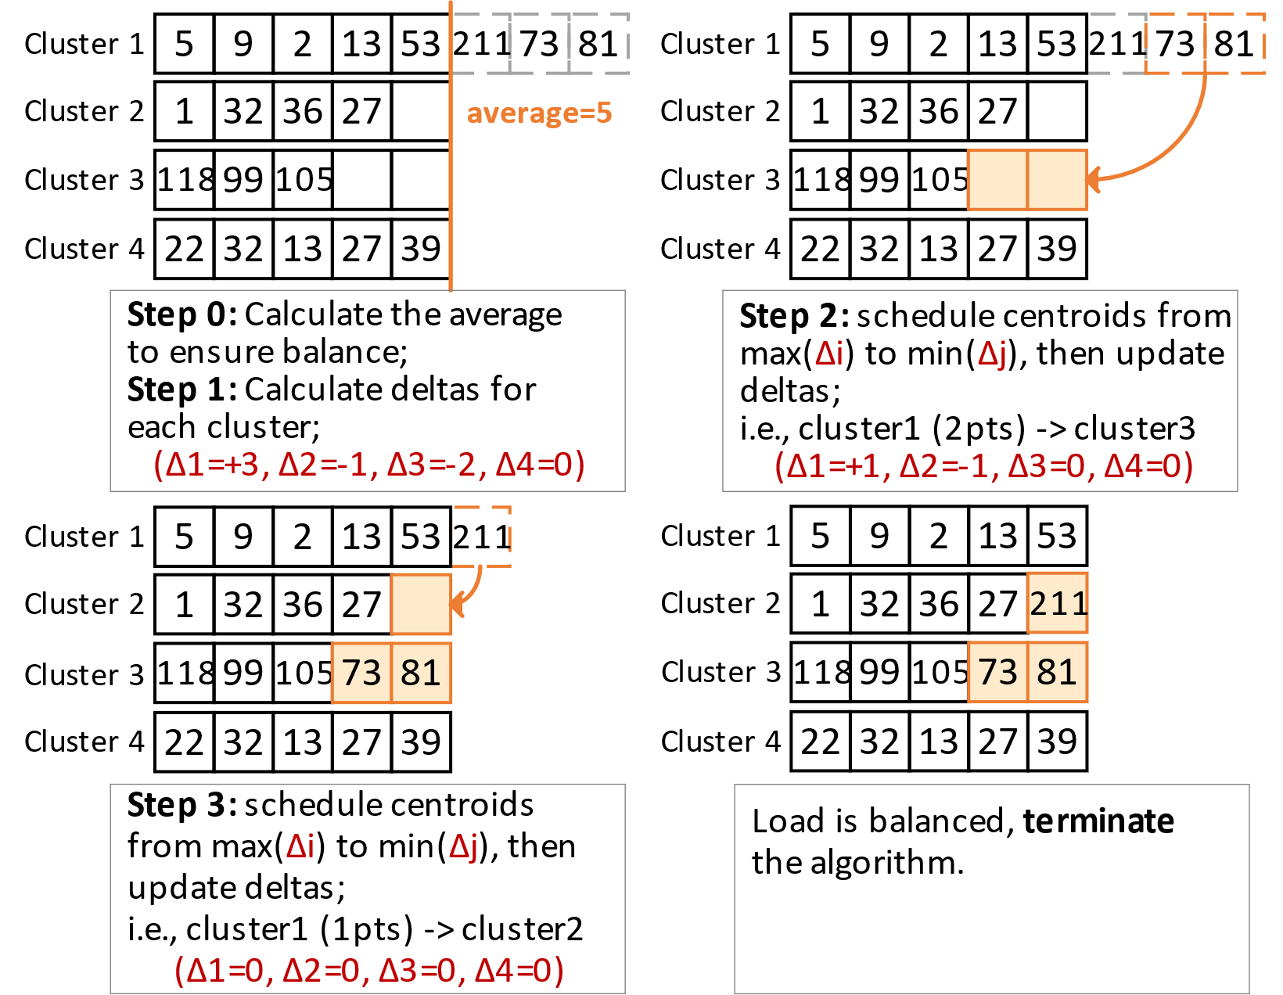
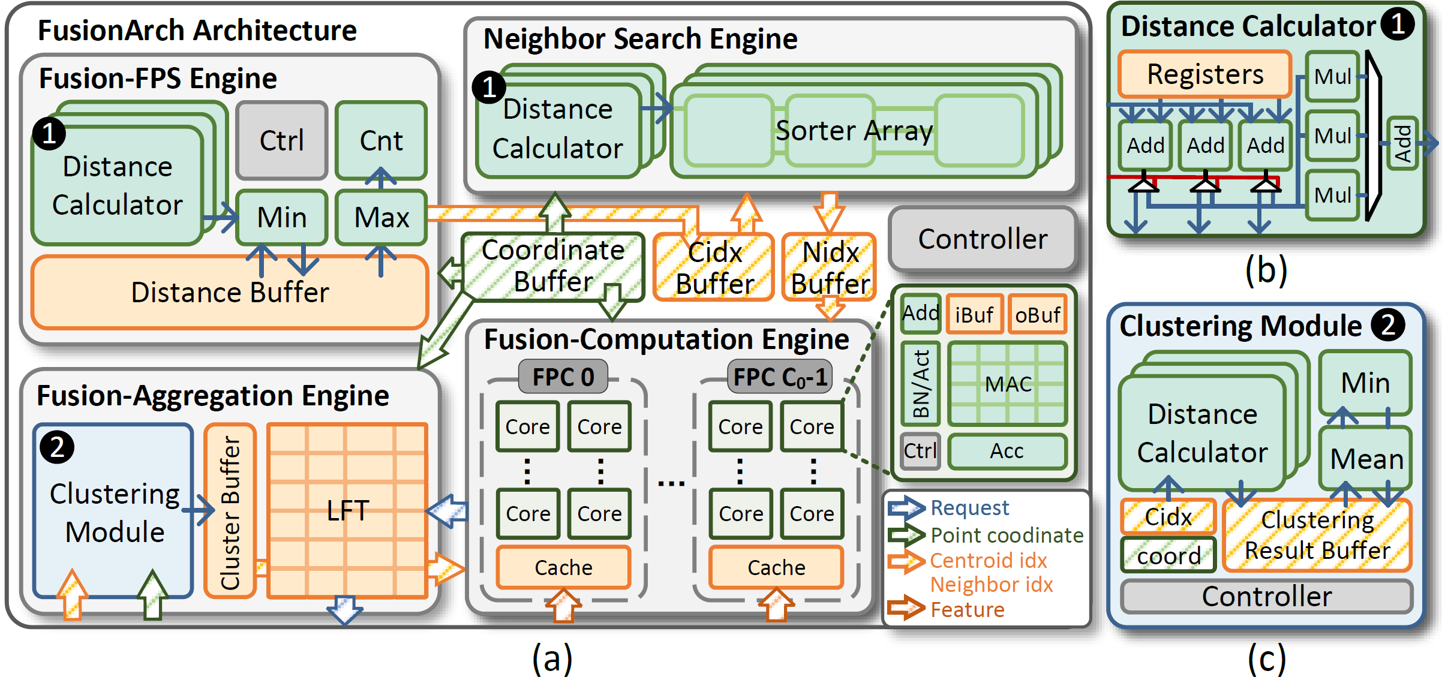
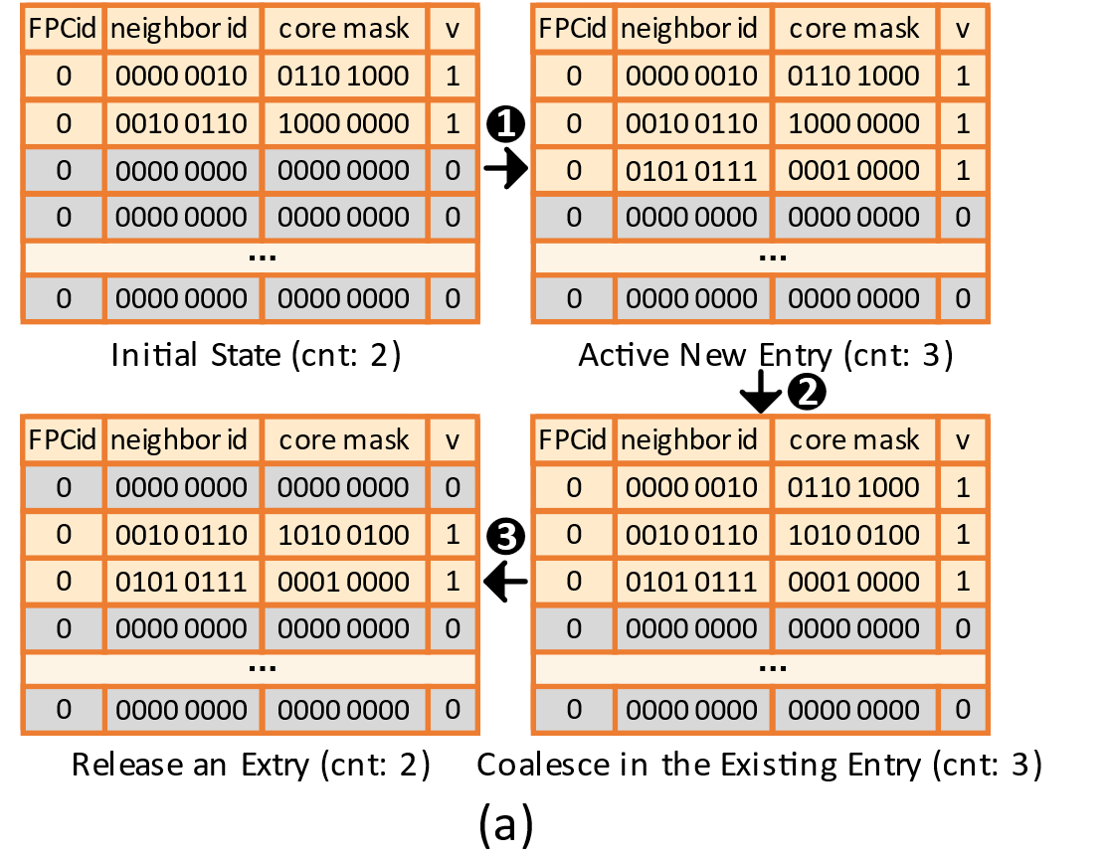
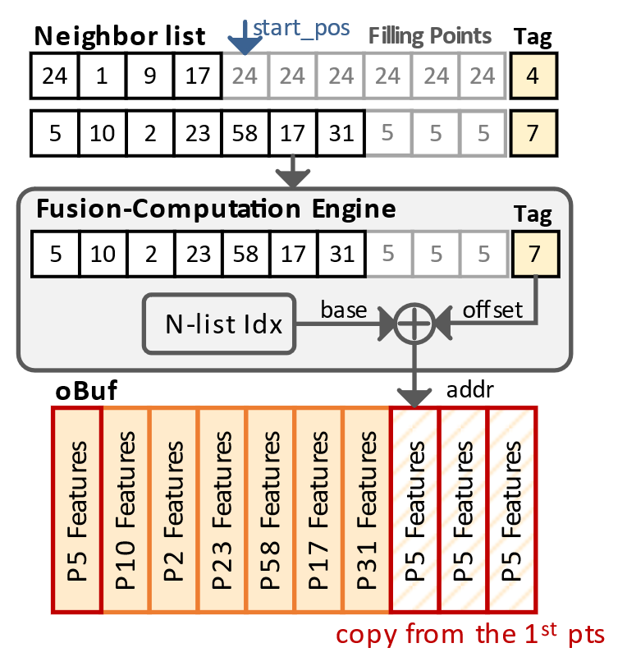
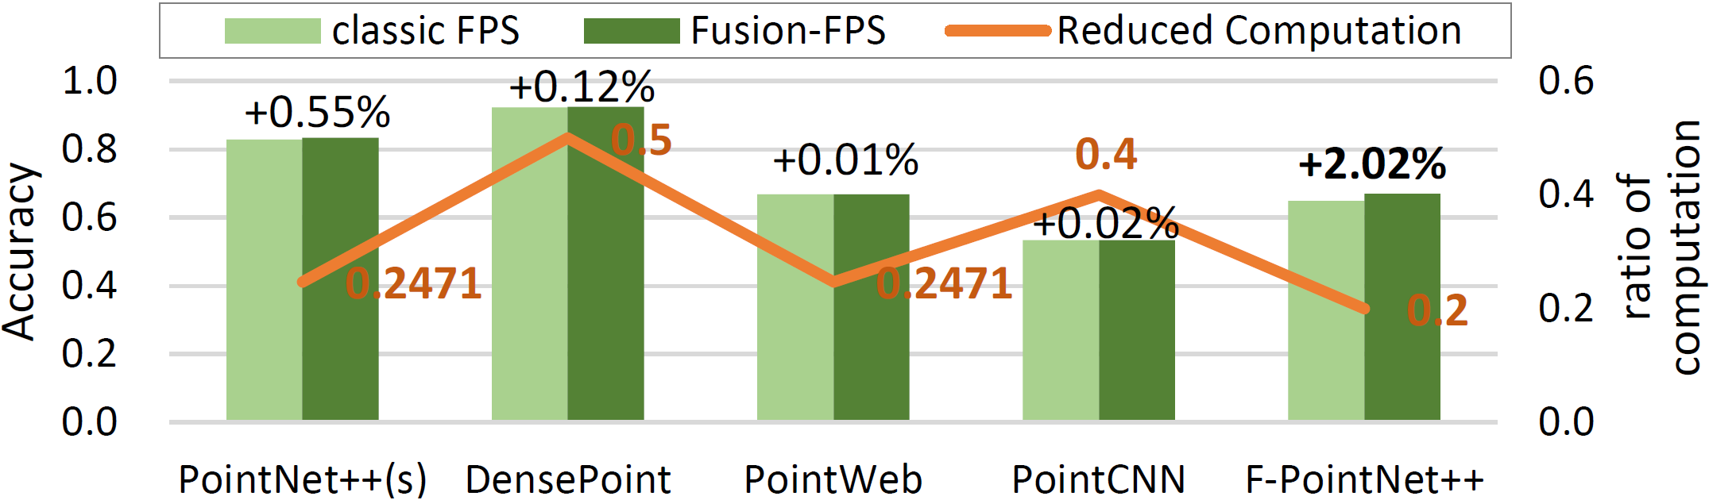
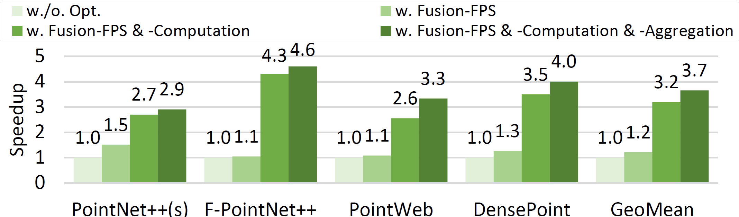
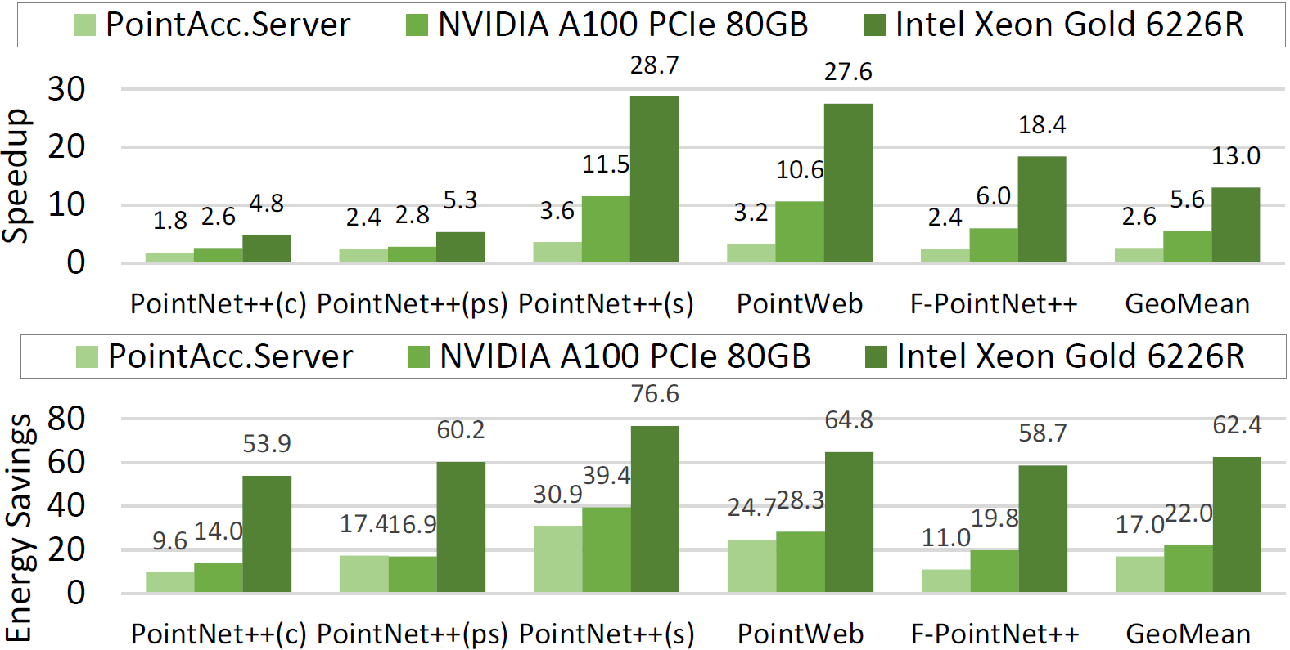
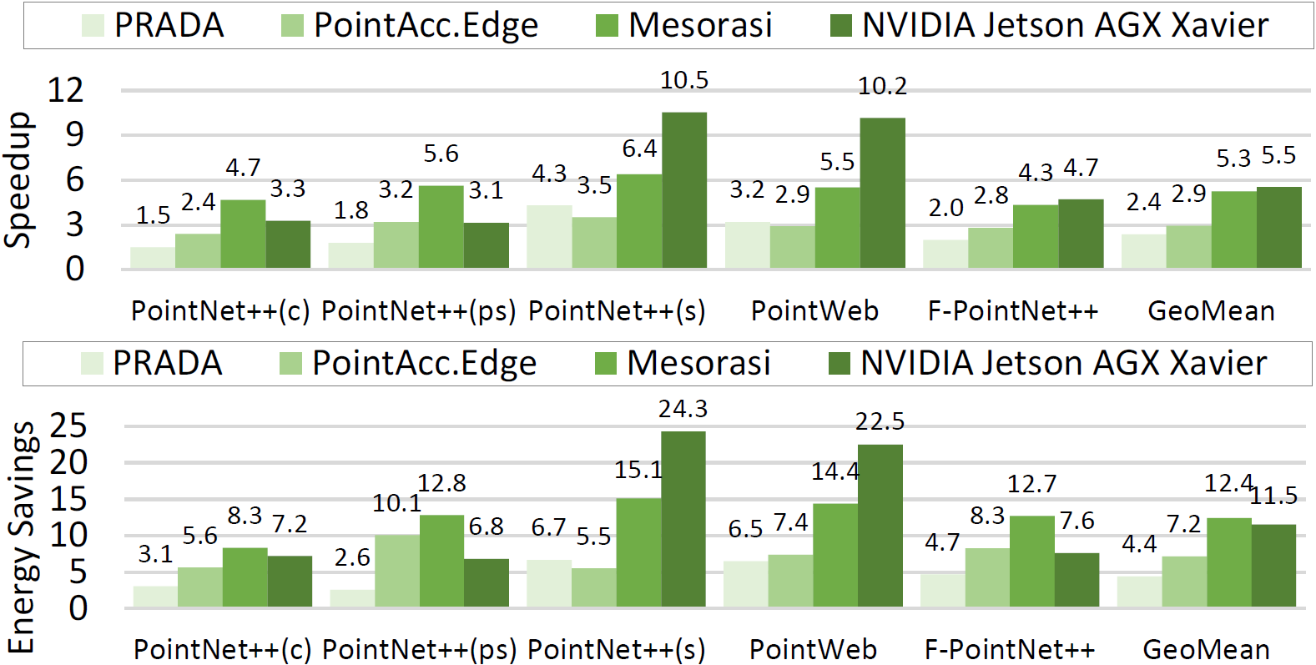
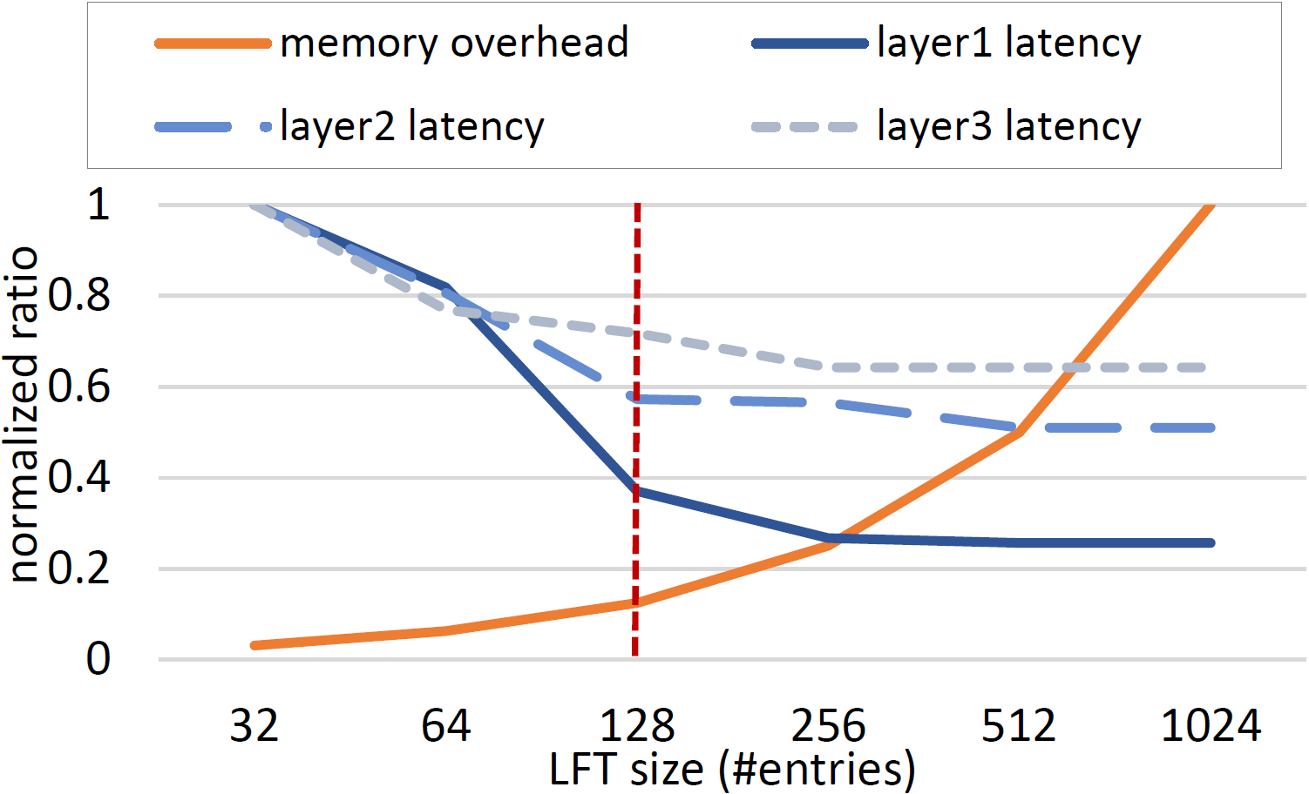
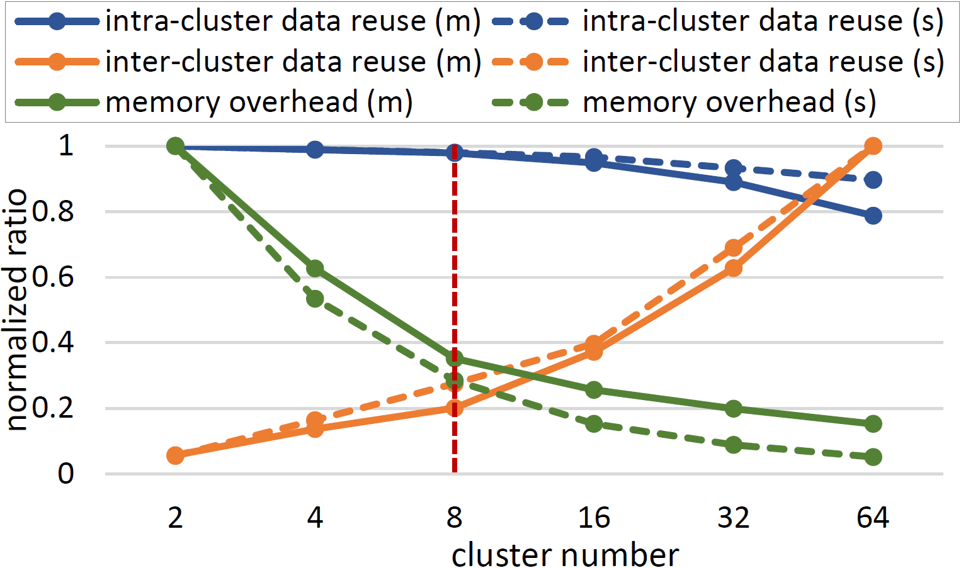
FusionArch: A Fusion-Based Accelerator for Point-Based Point Cloud Neural Networks
Xueyuan Liu, Zhuoran Song*, Guohao Dai, Gang Li, Can Xiao, Yan Xiang, Dehui Kong, Ke Xu and Xiaoyao Liang
Challenge & Solution Overview
STAGE | CHALLENGE | OUR SOLUTION
FPS | 96% of the execution time is consumed by FPS in PointNet++! | Fusion-FPS
Feature Computation | 64.8% neighbor lists contain “Filling Points”; 86.3% of them experience re-computation over 5 times! | Fusion-Computation
Aggregation | 73% features are accessed repeatedly over 4 times! | Fusion-Aggregation
Balanced K-Means
FusionArch
LFT
(a) The architecture of FusionArch, (b) distance calculator, (c) clustering module
Use LFT in Fusion-Aggregation to coalesce redundant access for shared neighbors
Fusion-Computation
Accuracy
Ablation Study
Achieving an accuracy improvement of up to 2.02%
Reduce the computation of FPS by 50% at most
Baseline accelerator (w./o.) + Fusion-FPS + Fusion-Computation + Fusion-Aggregation --> FusionArch.Edge
Fusion-FPS avoids the sampling shrinkage trend and exhibits stronger shape representation capabilities
Performance & Energy Efficiency
Exploration
The size of LFT
(Trade-off between performance and memory overhead)
The number of clusters
(Trade-off between data reuse and memory overhead)
FusionArch.Server with 4096 MACs and 334.6KB SRAM
FusionArch.Edge with 256 MACs and 83.8KB SRAM

Slide 2

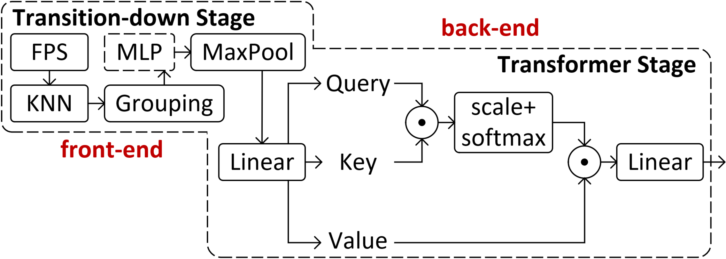
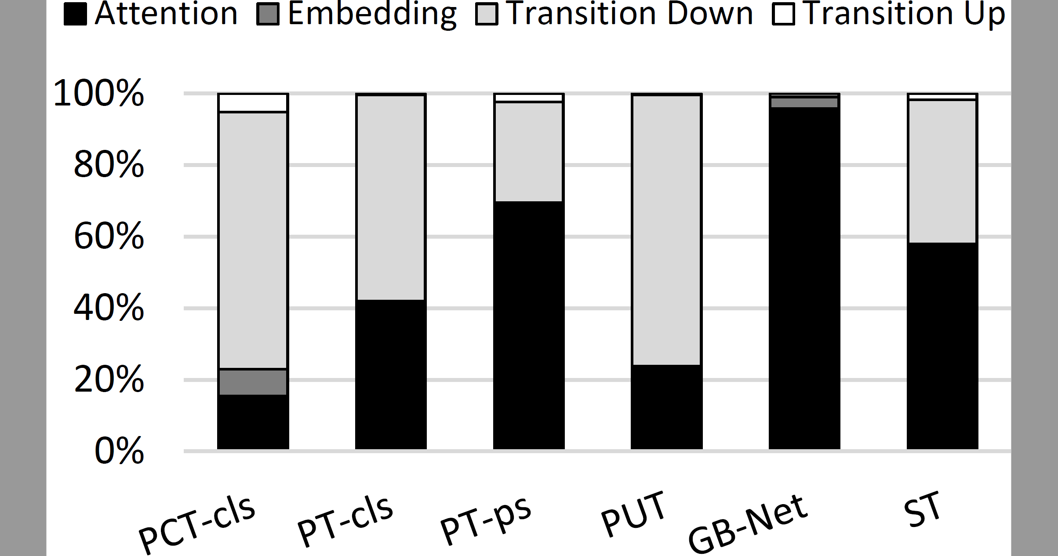
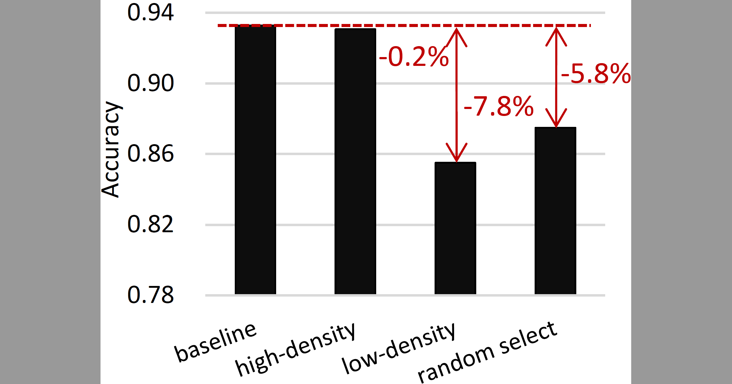
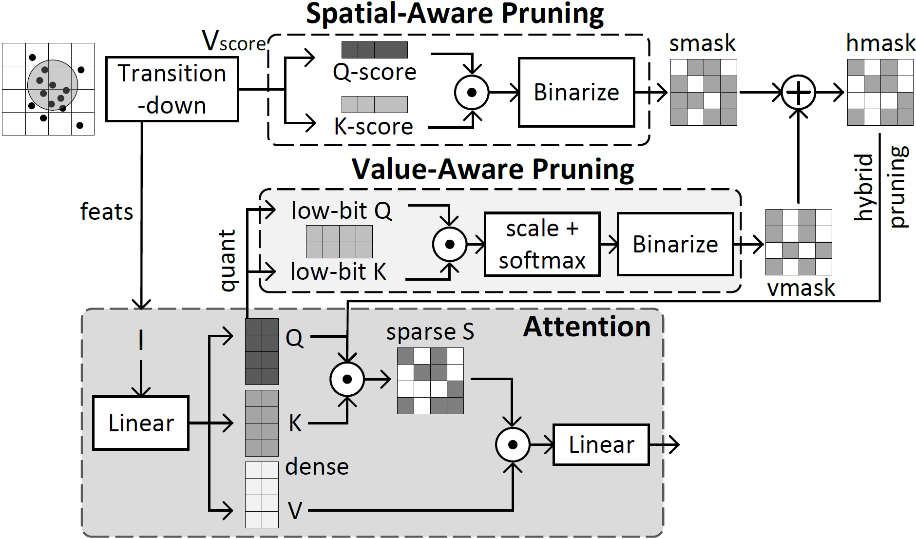
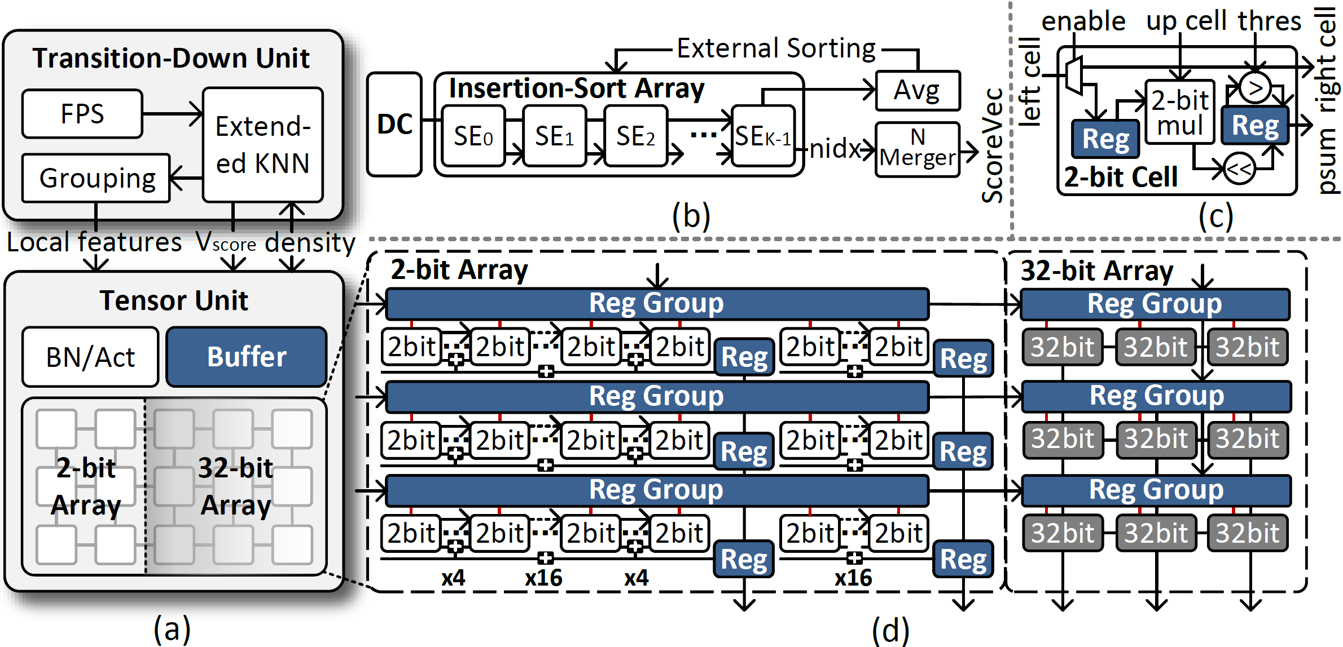
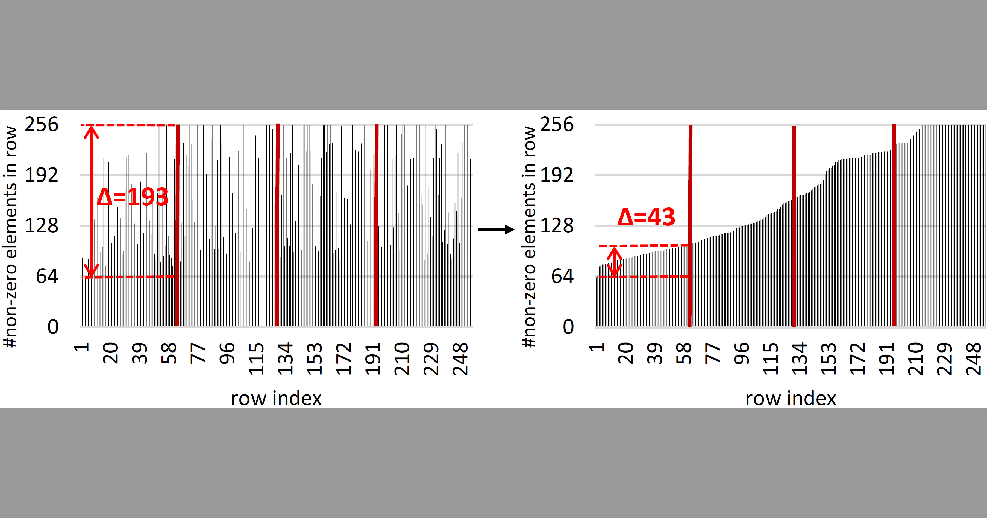
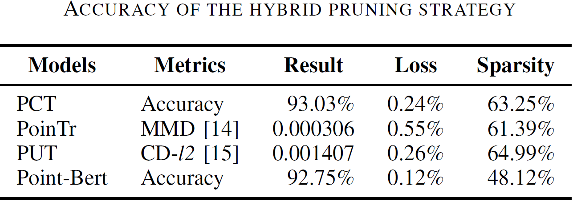
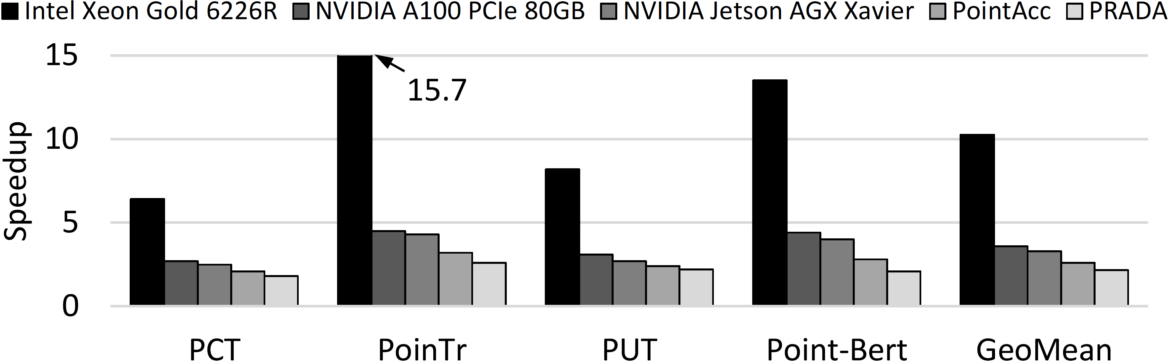
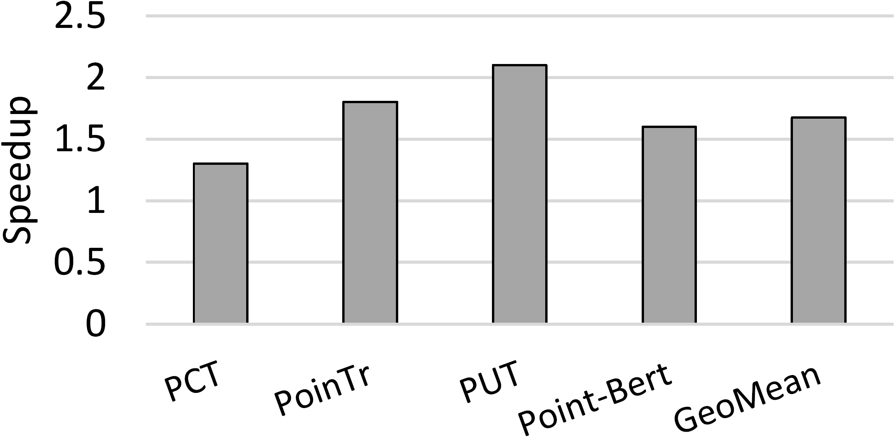
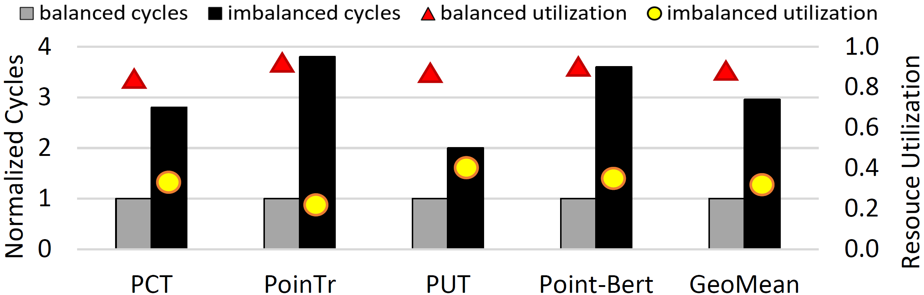
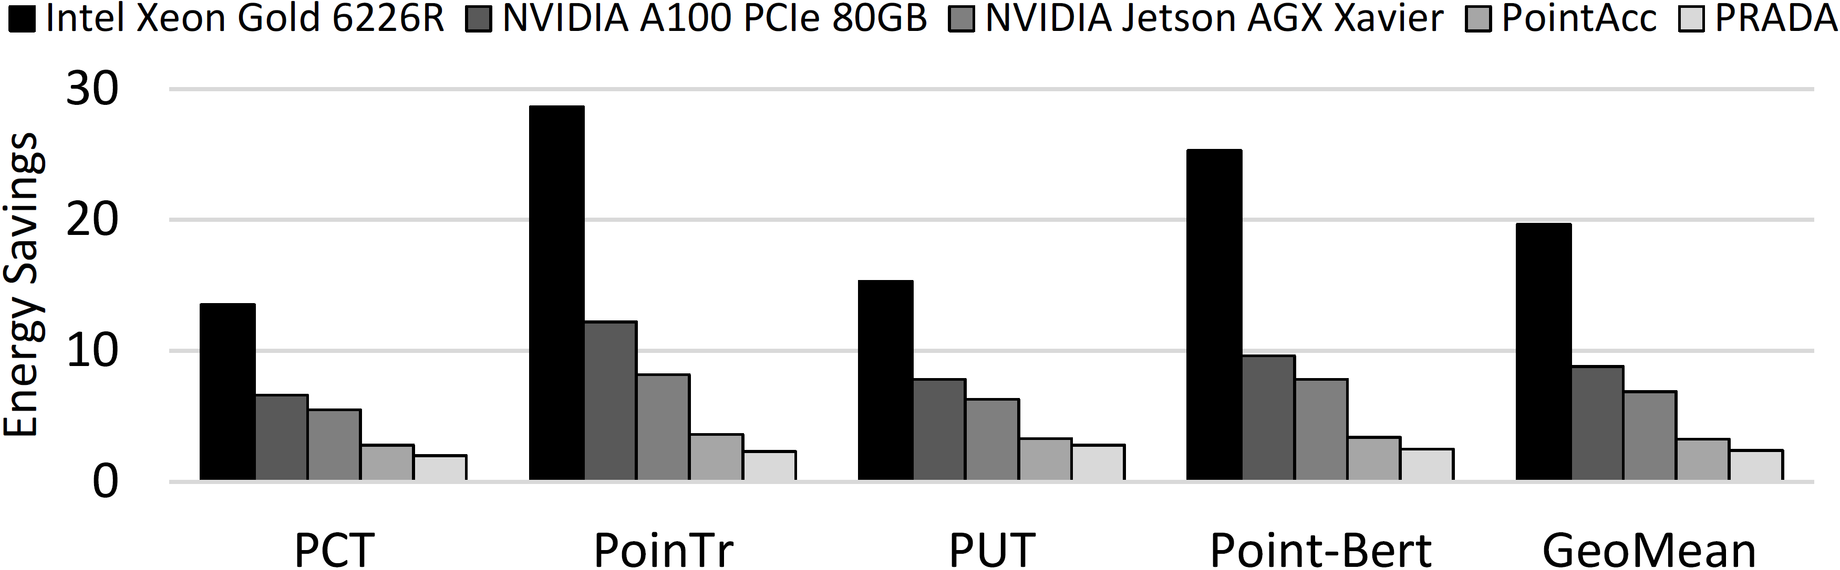
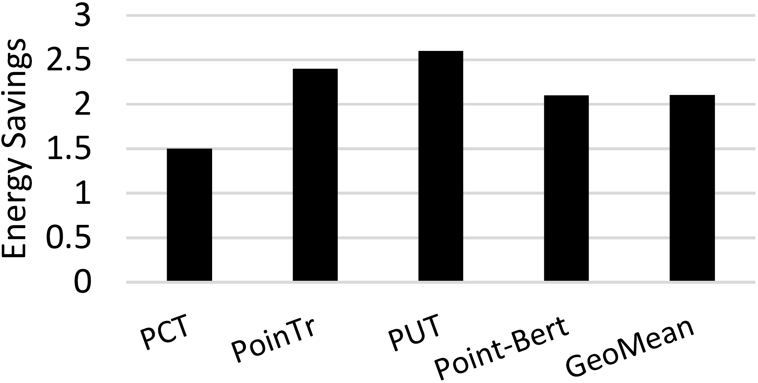
Sava: A Spatial- and Value-Aware Accelerator for Point Cloud Transformer
Xueyuan Liu, Zhuoran Song*, Xiang Liao, Xing Li, Tao Yang, Fangxin Liu and Xiaoyao Liang
Point Cloud Transformer
Motivation
Varying Bottlenecks
PCT-cls, PT-cls, PUT are hindered by the front-end.
PT-ps, GB-Net, ST are hindered by the back-end.
Front-end: traditional point-based PCNN.
Back-end: transformer-based feature extraction network.
Motivation-S
Algorithm
Motivation-V
[In Value] The importance varies across the magnitude of values.
Spatial- and value-aware hybrid pruning algorithm
[Spatial] Prune multiplications between less important regions.
[Value] Prune multiplications of small values.
[Hybrid] Hybridize both strategies to prune less critical MULs in S.
[In Spatial] The importance varies across regions with different densities.
Architecture
Scheduling
Challenge: workload imbalance among different rows due to non-uniform zero distributions.
Solution: rearrange rows of hmask and pack the rows with similar sparsity.
32-bit array for MLPs and attentions.
2-bit array for mask generation and 32-bit array extension.
Experiment
Accuracy
Performance
Generality
Orthogonal to PointAcc
Ablation Study
Energy Efficiency

